Slide 1




Infosys SpringBoard
DermaScan – AI-Powered Facial Skin Analysis Platform
End-to-End Deep Learning System with Real-Time Web Deployment
Presentation by Anu Sharma
Notes:
1

Slide 2
PROJECT ROADMAP
WHAT WE WILL
TALK ABOUT
01
02
Foundation
Technical Implementation
Overview, objectives, and dataset exploration
Methodology, preprocessing, and model architecture
03
04
Results & Insights
Live Demonstration
Training outcomes, challenges, and future directions
Interactive web application showcase
Notes:
2

Slide 3

PROJECT OVERVIEW: BRIDGING AI AND DERMATOLOGY
What is DermaScan?
DermaScan is an intelligent system that analyzes facial images using deep learning to identify skin conditions. The platform processes uploaded photos, detects facial regions, and provides instant classification with confidence scores.
Deployed as an accessible web application, it demonstrates practical AI implementation in healthcare, making skin condition analysis available for real-time use by students, researchers, and potential users.
Notes:
3

Slide 4




CORE OBJECTIVES
Detect Aging & Skin Conditions
Multi-Class Classification
Analyze facial images to identify various skin conditions and aging markers using computer vision techniques
Accurately classify images into four distinct categories: Clear Skin, Wrinkles, Dark Spots, and Puffy Eyes
Apply Transfer Learning
Web Deployment
Leverage pretrained EfficientNetB0 model for efficient feature extraction without training from scratch
Deliver predictions through an intuitive interface showing classification results and confidence percentages
Notes:
4

Slide 5
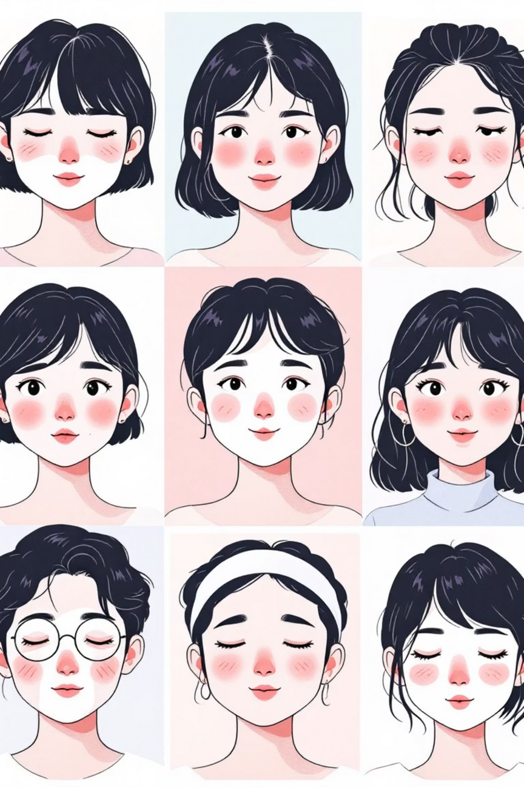
DATASET OVERVIEW
Initial Collection
100 images per class gathered through web scraping and manual filtering
Data Augmentation
Expanded to 500 images per class using rotation, flipping, and brightness adjustments
Four Distinct Classes
Clear Skin
Wrinkles
Dark Spots
Puffy Eyes
Smooth texture, even tone, no visible issues
Fine lines, texture-based aging patterns
Hyperpigmentation, uneven skin tone areas
Swelling localized around eye regions
Notes:
5

Slide 6







SYSTEM ARCHITECTURE
SYSTEM METHODOLOGY: FROM UPLOAD TO PREDICTION
The DermaScan pipeline transforms raw facial images into diagnostic predictions through a series of carefully orchestrated processing stages.
Image Upload
Face Detection
Preprocessing
User submits facial photograph through web interface
Haar Cascade algorithm isolates facial region from background
Image resized and normalized for neural network input
Feature Extraction
CNN Classification
Results Display
EfficientNetB0 extracts deep visual features from processed image
Convolutional layers classify skin condition category
Prediction shown with confidence score and interpretation

Slide 7
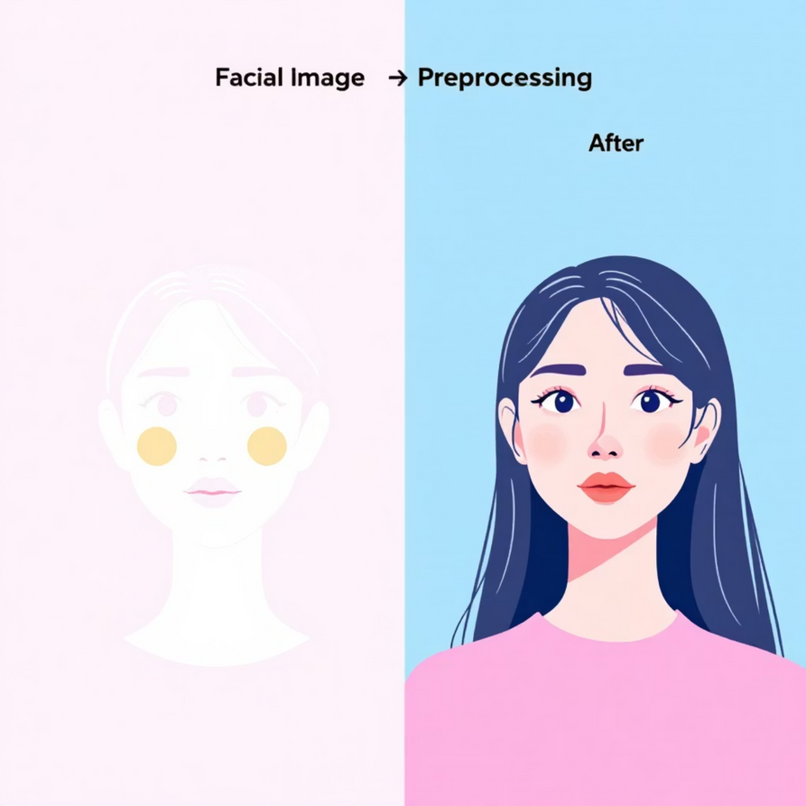



DATA PREPROCESSING PIPELINE
Preparing images for optimal model performance requires systematic preprocessing steps that ensure consistency across all inputs.
These preprocessing steps ensure consistent input distribution and improve generalization across varied facial images.
Face Detection
Haar Cascade algorithm locates facial region, eliminating background noise and focusing analysis on relevant areas
Image Resizing
All images standardized to 224×224 pixels to match EfficientNet input requirements
Pixel Normalization
EfficientNet-specific preprocessing applied to scale pixel values, improving training stability and convergence
Notes:
7

Slide 8

MODEL ARCHITECTURE: EFFICIENTNETB0 WITH CUSTOM LAYERS
Base Model: EfficientNetB0
1
Pretrained on ImageNet dataset, provides robust feature extraction capabilities without requiring millions of training images
2
Custom Dense Layers
Additional fully connected layers added to adapt general ImageNet features to specific skin condition patterns
Dropout Regularization
3
Dropout layers strategically placed to prevent overfitting by randomly deactivating neurons during training
4
Softmax Output Layer
Final layer with 4 neurons produces probability distribution across Clear Skin, Wrinkles, Dark Spots, and Puffy Eyes
Notes:
8

Slide 9
TRAINING & PERFORMANCE EVALUATION
Training Configuration
Results Achieved
The model demonstrated reliable classification performance across all four skin condition categories. Accuracy and loss metrics were continuously monitored throughout training to ensure optimal convergence.
Optimizer
Adam: Adaptive learning rate optimization for efficient convergence
Confidence-based predictions provide users with transparency about classification certainty, enabling informed interpretation of results.
Loss Function
Categorical Crossentropy: Standard for multi-class classification tasks
Training Accuracy: 95.6%
Validation Accuracy: 91.7%
Overfitting controlled using dropout and augmentation
Data Split
Training and validation sets with augmentation applied during training phase
Notes:
9

Slide 10
CHALLENGES
TECHNICAL OBSTACLES AND SOLUTIONS
1
2
Limited Dataset Size
Similar Visual Patterns
Original training data contained insufficient samples for robust deep learning. We applied extensive data augmentation techniques including rotation, flipping, brightness adjustment, and zoom to artificially expand the dataset.
Some skin conditions exhibit overlapping visual characteristics, creating classification ambiguity. Transfer learning from EfficientNetB0's pre-trained weights helped capture subtle distinguishing features.
3
4
Environmental Sensitivity
Overfitting Risk
Model performance varied significantly with lighting conditions and image quality. Robust preprocessing and normalization pipelines improved consistency across diverse input conditions.
Small dataset sizes increased overfitting vulnerability. We employed dropout layers, early stopping, and regularization techniques alongside augmentation to improve generalization.

Slide 11

FUTURE DEVELOPMENT
ROADMAP FOR ENHANCED CAPABILITIES
Several strategic improvements will expand DermaScan's diagnostic scope and clinical utility.
Expanded Condition Library
Advanced Face Detection
Mobile Deployment
Personalized Recommendations
Incorporate additional skin conditions including acne, hyperpigmentation, rashes, eczema, and psoriasis to provide comprehensive dermatological coverage.
Upgrade to sophisticated facial landmark detection using deep learning models like MTCNN or Mediapipe for improved accuracy and robustness across diverse demographics.
Develop native iOS and Android applications with offline inference capabilities, making skin analysis accessible anywhere without internet connectivity.
Integrate skincare product suggestions and treatment guidance based on detected conditions, skin type analysis, and evidence-based dermatological protocols.

Slide 12

PROJECT OUTCOMES AND KEY LEARNINGS
End-to-End AI System
Successfully built complete pipeline from image acquisition through preprocessing, model inference, and result visualization—demonstrating full-stack ML engineering capabilities.
Healthcare AI Application
Practical implementation of deep learning in medical domain, addressing real diagnostic needs while understanding ethical considerations and limitations.
Computer Vision Expertise
Gained hands-on experience with facial detection algorithms, CNN architectures, transfer learning, and image preprocessing techniques essential for production systems.
Technical Achievement: This project demonstrates the practical application of modern deep learning frameworks, computer vision libraries, and web deployment strategies in solving real-world healthcare challenges.

Slide 13

Live Demo
Experience DermaScan in Action
The fully functional web application is deployed and ready for testing. Upload a facial image to see real-time skin condition analysis powered by our trained neural network.
THANK YOU
QUESTIONS WELCOME
We appreciate your time and attention in reviewing this project presentation.
We're happy to discuss technical implementation, challenges faced, or future development plans.

